Slide 1
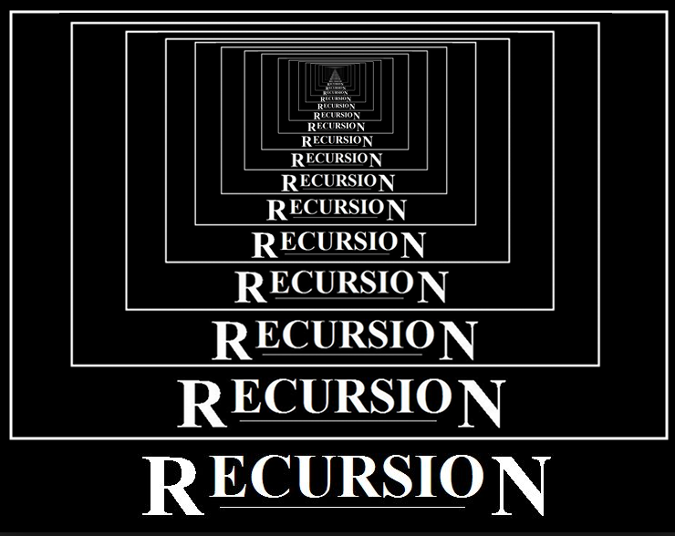

Slide 2

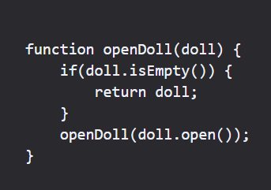
When you open a doll, you find another doll inside, and when you open that one, there's another one inside. The act of doing this is called RECURSION.
Do you know Matryoshka dolls?

Slide 3
What is Recursion?
A procedure defined in terms of (simpler versions of) itself
Components:
Base case
Recursive definition
Convergence to base case

Slide 4
Example: Factorial
Given n ≥ 0:
n! = n × (n - 1) × (n - 2) ×  × 2 × 1
0! = 1
Example:
5! = 5 × 4 × 3 × 2 × 1 = 120

Slide 5
Example: Factorial
Problem: Write a recursive function Factorial(n) which computes the value of n!
Base Case:
If n = 0 or n = 1:
Factorial(n) = 1

Slide 6
Example: Factorial
Recursion:
n! = n × (n - 1) × (n - 2) ×  × 2 × 1
(n - 1)!
If n > 1:
Factorial(n) = n × Factorial(n - 1)

Slide 7
Example: Factorial
Convergence:
Factorial(4)
4
×
Factorial(3)
3
×
Factorial(2)
2
×
Factorial(1)
1

Slide 8
Example: Factorial
The Factorial function can be defined recursively as follows:
Factorial(0) = 1
Factorial(1) = 1
Factorial(n) = n × Factorial(n - 1)

Slide 9
Example: Factorial
Factorial ( n )
if ( n is less than or equal to 1 ) then
return 1
else
return n × Factorial ( n - 1 )

Slide 10
Example: Factorial
Base case
Factorial ( n )
if ( n is less than or equal to 1 ) then
return 1
else
return n × Factorial ( n - 1 )

Slide 11
Example: Factorial
General Case
Factorial ( n )
if ( n is less than or equal to 1 ) then
return 1
else
return n × Factorial ( n - 1 )

Slide 12
Example: Factorial
Recursion
Factorial ( n )
if ( n is less than or equal to 1 ) then
return 1
else
return n × Factorial ( n - 1 )

Slide 13
Example: Factorial
Convergence
Factorial ( n )
if ( n is less than or equal to 1 ) then
return 1
else
return n × Factorial ( n - 1 )

Slide 14
Example: Factorial
Factorial(4)
4
×
Factorial(3)
3
×
Factorial(2)
2
×
Factorial(1)
1

Slide 15
Example: Factorial
Factorial(4)
4
×
Factorial(3)
3
×
Factorial(2)
2
×
Factorial(1)
1

Slide 16
Example: Factorial
Factorial(4)
4
×
Factorial(3)
3
×
Factorial(2)
2
×
1

Slide 17
Example: Factorial
Factorial(4)
4
×
Factorial(3)
3
×
Factorial(2)
2
×
1

Slide 18
Example: Factorial
Factorial(4)
4
×
Factorial(3)
3
×
2

Slide 19
Example: Factorial
Factorial(4)
4
×
Factorial(3)
3
×
2

Slide 20
Example: Factorial
Factorial(4)
4
×
6

Slide 21
Example: Factorial
Factorial(4)
4
×
6

Slide 22
Example: Factorial
24

Slide 23
Example:
Computes the factorial of a number
Factorial ( n )
if ( n is less than or equal to 1)
then
return 1
else
return n × Factorial ( n - 1 )
/* Compute the factorial of n */
def factorial( n ):
if ( n <= 1 ):
return 1
else:
return n * factorial(n-1)

Slide 24
Example: “Frames” during calculation of factorial(4)
print(factorial(4))

Slide 25
Example: “Frames” during calculation of factorial(4)
print(factorial(4))
def factorial ( n ):
if ( n <= 1 ):
return 1
else:
return n * factorial( n - 1 )
n:
4
4
4
4

Slide 26
Example: “Frames” during calculation of factorial(4)
print(factorial(4))
def factorial ( n ):
if ( n <= 1 ):
return 1
else:
return n * factorial( n - 1 )
n:
4
4
4
3

Slide 27
Example: “Frames” during calculation of factorial(4)
print(factorial(4))
def factorial ( n )
if ( n <= 1 )
return 1
else
return n * factorial( n - 1 )
n:
4
def factorial ( n ):
if ( n <= 1 ):
return 1:
else:
return n * factorial( n - 1 )
n:
3
4
3
4
3
3
3

Slide 28
Example: “Frames” during calculation of factorial(4)
print(factorial(4))
def factorial ( n )
if ( n <= 1 )
return 1
else
return n * factorial( n - 1 )
n:
4
def factorial ( n ):
if ( n <= 1 ):
return 1
else:
return n * factorial( n - 1 )
n:
3
4
3
4
3
3
2

Slide 29
Example: “Frames” during calculation of factorial(4)
print(factorial(4))
def factorial ( n )
if ( n <= 1 )
return 1
else
return n * factorial( n - 1 )
n:
4
def factorial ( n )
if ( n <= 1 )
return 1
else
return n * factorial( n - 1 )
n:
3
4
def factorial ( n ):
if ( n <= 1 ):
return 1
else:
return n * factorial( n - 1 )
3
n:
2
2
4
3
3
2
2
2

Slide 30
Example: “Frames” during calculation of factorial(4)
print(factorial(4))
def factorial ( n )
if ( n <= 1 )
return 1
else
return n * factorial( n - 1 )
n:
4
def factorial ( n ):
if ( n <= 1 )
return 1
else
return n * factorial( n - 1 )
n:
3
4
def factorial ( n ):
if ( n <= 1 ):
return 1
else:
return n * factorial( n - 1 )
3
n:
2
2
4
3
3
2
2
1

Slide 31
Example: “Frames” during calculation of factorial(4)
print(factorial(4))
def factorial ( n )
if ( n <= 1 )
return 1
else
return n * factorial( n - 1 )
n:
4
def factorial ( n )
if ( n <= 1 )
return 1
else
return n * factorial( n - 1 )
n:
3
4
def factorial ( n )
if ( n <= 1 )
return 1
else
return n * factorial( n - 1 )
3
n:
2
def factorial ( n ):
if ( n <= 1 ):
return 1
else:
return n * factorial( n - 1 )
n:
1
2
1
4
3
3
2
2
1

Slide 32
Example: “Frames” during calculation of factorial(4)
print(factorial(4))
def factorial ( n )
if ( n <= 1 )
return 1
else
return n * factorial( n - 1 )
n:
4
def factorial ( n )
if ( n <= 1 )
return 1
else
return n * factorial( n - 1 )
n:
3
4
def factorial ( n )
if ( n <= 1 )
return 1
else
return n * factorial( n - 1 )
3
n:
2
def factorial ( n ):
if ( n <= 1 ):
return 1
else:
return n * factorial( n - 1 )
n:
1
2
1
4
3
Base case:
factorial(1) is 1
return 1
3
2
2
1

Slide 33
Example: “Frames” during calculation of factorial(4)
print(factorial(4))
def factorial ( n )
if ( n <= 1 )
return 1
else
return n * factorial( n - 1 )
n:
4
def factorial ( n )
if ( n <= 1 )
return 1
else
return n * factorial( n - 1 )
n:
3
4
def factorial ( n ):
if ( n <= 1 ):
return 1
else:
return n * factorial( n - 1 )
3
n:
2
2
4
3
3
2
2
1
1

Slide 34
Example: “Frames” during calculation of factorial(4)
print(factorial(4))
def factorial ( n )
if ( n <= 1 )
return 1
else
return n * factorial( n - 1 )
n:
4
def factorial ( n )
if ( n <= 1 )
return 1
else
return n * factorial( n - 1 )
n:
3
4
def factorial ( n ):
if ( n <= 1 ):
return 1
else:
return n * factorial( n - 1 )
3
n:
2
2
4
3
3
2
2
2
1

Slide 35
Example: “Frames” during calculation of factorial(4)
print(factorial(4))
def factorial ( n )
if ( n <= 1 )
return 1
else
return n * factorial( n - 1 )
n:
4
def factorial ( n )
if ( n <= 1 )
return 1
else
return n * factorial( n - 1 )
n:
3
4
def factorial ( n ):
if ( n <= 1 ):
return 1
else:
return n * factorial( n - 1 )
3
n:
2
2
factorial(2) is 2
4
3
3
2
2

Slide 36
Example: “Frames” during calculation of factorial(4)
print(factorial(4))
def factorial ( n )
if ( n <= 1 )
return 1
else
return n * factorial( n - 1 )
n:
4
def factorial ( n ):
if ( n <= 1 ):
return 1
else:
return n * factorial( n - 1 )
n:
3
4
3
4
3
3
2
2

Slide 37
Example: “Frames” during calculation of factorial(4)
print(factorial(4))
def factorial ( n )
if ( n <= 1 )
return 1
else
return n * factorial( n - 1 )
n:
4
def factorial ( n ):
if ( n <= 1 ):
return 1
else:
return n * factorial( n - 1 )
n:
3
4
3
4
3
3
3
2

Slide 38
Example: “Frames” during calculation of factorial(4)
print(factorial(4))
def factorial ( n )
if ( n <= 1 )
return 1
else
return n * factorial( n - 1 )
n:
4
def factorial ( n ):
if ( n <= 1 ):
return 1
else:
return n * factorial( n - 1 )
n:
3
4
3
factorial(3) is 6
4
3
6
2

Slide 39
Example: “Frames” during calculation of factorial(4)
print(factorial(4))
def factorial ( n ):
if ( n <= 1 ):
return 1
else:
return n * factorial( n - 1 )
n:
4
4
4
3
6

Slide 40
Example: “Frames” during calculation of factorial(4)
print(factorial(4))
def factorial ( n ):
if ( n <= 1 ):
return 1
else:
return n * factorial( n - 1 )
n:
4
4
4
4
6

Slide 41
Example: “Frames” during calculation of factorial(4)
print(factorial(4))
factorial ( n )
if ( n <= 1 )
return 1
else
return n * factorial( n - 1 )
n:
4
4
factorial(4) is 24
24

Slide 42
Example: “Frames” during calculation of factorial(4)
print(factorial(4))
24
Output: 24

Slide 43
A Question
How many people here don’t like recursion?
Since you do not know?
You prefer iteration or recursion?
Why not?
A Promise: By the end of this lecture, you will say:
“Recursion Rocks My World!”

Slide 44
Recursion
Let’s say you place two rabbits in a hutch.
What’s going to happen?

Slide 45
Two Months Later...
original rabbits
new rabbits
If it takes two months for rabbits to reach maturity, in two months you’ll have one productive pair and one (brand new) non-productive pair. (This assumes all rabbits live up to their reputation.)

Slide 46
The rabbits keep at it.
1 month old
0 months old
The next month, you get another pair . . .

Slide 47
Suppose
What if:
The rabbits always had two offspring, always
male and female
Rabbits always reached maturity in two months
No rabbit dies.
How many pairs of rabbits do you have in a year?
1
2
3

Slide 48
Hare Raising Story
KEY
Start
(0,,,,,)
= one m/f pair
End Month 1
(1,,,,,)
End Month 2
(2,0,,,,)
End Month 3
(3,1,0,,,)
End Month 4
(4,2,1,0,0,)
(5,3,2,1,1,0,0,0)
End Month 5

Slide 49
Pairs of Rabbits
Month
Productive
Non-Productive
Total
1
0
1
1
2
1
0
1
3
1
1
2
4
2
1
3
See a
pattern
yet?
5
3
2
5
6
5
3
8
7
8
5
13
8
13
8
21
9
21
13
34
10
34
21
55
11
55
34
89
12
89
55
144

Slide 50
Let’s Take Another Example
Instead of rabbits, let’s use geometry.
Draw a square of size 1.
Rotating 90 degrees, add to it a square of size 1.
Rotating 90 degrees again, add a square of size 2.
Again, rotate and add a square of size 3, and so on.
Keep this up for the sequence we noted in the table:
1, 1, 2, 3, 5, 8, 13, 21, . . . ,
What do you see?

Slide 51
1

Slide 52
1

Slide 53
2

Slide 54
3

Slide 55
5

Slide 56
8

Slide 57
13

Slide 58
21

Slide 59
13
21
2
3
1
1
8
5

Slide 60
Does this look familiar?

Slide 61
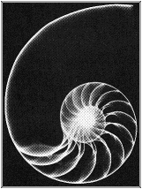
It’s not just about rabbits.

Slide 62
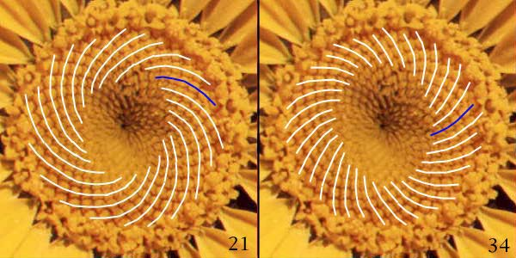
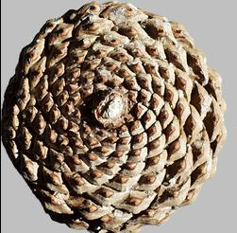
The Truth
is Out There

Slide 63
See the pattern?
Month
Productive
Non-Productive
Total
1
0
1
1
2
1
0
1
3
1
1
2
4
2
1
3
5
3
2
5
It’s the Fibonacci
Sequence.
6
5
3
8
7
8
5
13
8
13
8
21
9
21
13
34
10
34
21
55
11
55
34
89
12
89
55
144
We used brute force to find the progression:
1, 1, 2, 3, 5, 8, 13, 21, 34, 55, 89, 144, ... ,
It turns out this pattern is repeated in many places: sea shells, sun flowers, pine cones, the stock market, bee hives, etc.

Slide 64
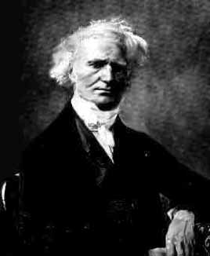
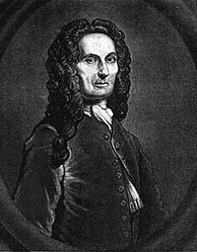
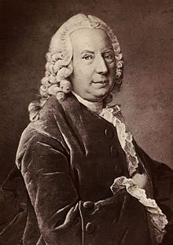
Writing the Formula
Given:
1, 1, 2, 3, 5, 8, 13, 21, 34, 55, 89, 144, ... ,
Can we write this as a formula for any number, n?
n
n
1+
5
1-
5
Fib(n) =
-
2
2
These guys could:
The Fibonacci numbers have a closed-form solution. It has become known as "Binet's formula" (Jacques Philippe Marie Binet), though it was already known by Abraham de Moivre and Daniel Bernoulli
But let’s be honest.
We’re not as smart as them.
But that’s OK. We can code.

Slide 65
What If You Can’t Find the Formula?
Which one
would you
rather code
and debug?
For some
problems,
there might
not exist a
formula, and
recursion is
your only
option.
Suppose you didn’t know:
n
n
1+
5
1-
5
Fib(n) =
-
2
2
You could take Math or you could
instead manage with:
Fib(n) = Fib(n-1) + Fib(n-2),
Fib(0) = 0
Fib(1) = 1
(The value at any given place is the sum of the two prior values.)

Slide 66
Recursive Fibonacci
We have our general rule:
Fib(n) = Fib(n-1) + Fib(n-2),
Fib(0) = 0
Fib(1) = 1
We can say a few things about it:
It’s defined recursively (duh).
It has a terminal condition (AHA!)
It can be determined and calculated (addition).
1
2
3

Slide 67
Coding Fibonacci
def fib(num):
What do we know to
start with? We know that
we need a function that
return the Fibonacci
value for a number at a
given position.
This suggests a function
that gives and gets a number

Slide 68
Coding Fibonacci
def fib(num):
if num == 0:
return 0
What’s the FIRST thing we do
with a recursive function?
We plan on how it will terminate!
We know one special case
for the Fibonacci sequence:
F(0) = 0

Slide 69
Coding Fibonacci
def fib(num):
if num == 0:
return 0
elif num == 1:
return 1
We also know a
second special case
that could terminate
our recursion:
F(1) = 1.

Slide 70
Coding Fibonacci
def fib(num):
if num == 0:
return 0
elif num == 1:
return 1
else:
return fib(num-1) + fib(num-2)
The last part of our
formula is merely:
F(n) = F(n-1) + F(n-2)

Slide 71
Recursion Review
So far, we’ve seen that for recursive behavior:
1) Recursion exists in all of nature.
2) It’s easier than memorizing a formula. Not every problem has a formula, but every problem can be expressed as a series of small, repeated steps.
3) Each step in a recursive process should be small, calculable, etc.
4) You absolutely need a terminating condition.

Slide 72
Honesty in Computer Science
1. To make life easy the typical examples given for recursion are factorial and the Fibonacci numbers.
2. Truth is the Fibonacci is a horror when calculated using “normal” recursion and there’s not really any big advantage for factorial.
3. So why all the fuss about recursion?
4. Recursion is absolutely great when used to write algorithms for recursively defined data structures like binary trees. Much easier than iteration!
5. Recursion is excellent for any divide & conquer algorithm like...

Slide 73
One More Example
Suppose we wanted to create a function that solve:
Pow(x, y) = x^{y}
In other words, the function returned the value of one number raised to the power of another:
def pow(value, exponent)

Slide 74
Planning the function
Unlike the Fibonacci example, our mathematical formula is not the complete answer.
Pow(x, y) = x^{y}
We’re missing some termination conditions.
But we know:
x¹ = x
x⁰ = 1
So we could use these as our terminating condition.

Slide 75
Attempt #1
def pow(value, exponent):
if exponent == 0:
return 1
Always, always start with
some sort of terminating
condition. We know any number
raised to the zero power is one.

Slide 76
Attempt #1
def pow(value, exponent):
if exponent == 0:
return 1
elif exponent == 1:
return value
else:
exponent = exponent - 1
return value * pow (value, exponent)
... and any number raised to the
power of one is itself.
And rest is the recursive step

Slide 77
“Do I Have to Use Recursion?”
def pow(value, exponent):
if exponent == 0:
return 1
elif exponent == 1:
return value
else:
exponent = exponent - 1
return value * pow (value, exponent)
How many would have preferred to do this with a “for loop” structure or some other iterative solution?
How many think we can make our recursive function even faster than iteration?

Slide 78
Nota Bene
Our power function works through brute force recursion.
2⁸ = 2 * 2 * 2 * 2 * 2 * 2 * 2 * 2
But we can rewrite this brute force solution into two equal halves:
2⁸ = 2⁴ * 2⁴
and
2⁴ = 2² * 2²
and
2² = 2¹ * 2¹
and
anything to the power 1 is itself!

Slide 79
And here's the cool part...
2⁸ = 2⁴ * 2⁴
Since these are the same, we don't have to calculate them both!

Slide 80
AHA!
So only THREE multiplication operations have to take place:
2⁸ = 2⁴ * 2⁴
2⁴ = 2² * 2²
2² = 2¹ * 2¹
So the trick is knowing that 2⁸ can be solved by dividing the problem in half and using the result twice!

Slide 81
"But wait," I hear you say!
You picked an even power of 2. What about our friends the odd numbers?
Okay we can do odds like this:
2^{odd} = 2 * 2 ^{(odd-1)}

Slide 82
"But wait," I hear you say!
You picked a power of 2. That's a no brainer!
Okay how about 2²¹
2²¹ = 2 * 2²⁰ (The odd number trick)
2²⁰ = 2¹⁰ * 2¹⁰
2¹⁰ = 2⁵ * 2⁵
2⁵ = 2 * 2⁴
2⁴ = 2² * 2²
2² = 2¹ * 2¹

Slide 83
"But wait," I hear you say!
You picked a power of 2. That's a no brainer!
Okay how about 2²¹
2²¹ = 2 * 2²⁰ (The odd number trick)
2²⁰ = 2¹⁰ * 2¹⁰
2¹⁰ = 2⁵ * 2⁵
2⁵ = 2 * 2⁴
2⁴ = 2² * 2²
2² = 2¹ * 2¹
That's 6 multiplications
instead of 20 and it gets
more dramatic as the
exponent increases

Slide 84
The Recursive Insight
If the exponent is even, we can divide and conquer so it can be solved in halves.
If the exponent is odd, we can subtract one, remembering to multiply the end result one last time.
We begin to develop a formula:
Pow(x, e) = 1, where e == 0
Pow(x, e) = x, where e == 1
Pow(x, e) = Pow(x, e/2) * Pow(x,e/2), where e is even
Pow(x, e) = x * Pow(x, e-1), where e > 1, and is odd

Slide 85
Solution #2
def pow(value, exponent):
if exponent == 0:
return 1
elif exponent == 1:
return value
We have the same base
termination conditions
as before, right?

Slide 86
Solution #2
def pow(value, exponent):
if exponent == 0:
return 1
elif exponent == 1:
return value
elif exponent % 2 == 0:
exponent = exponent // 2
We next divide the
exponent in half.

Slide 87
Solution #2
def pow( value, exponent):
if exponent == 0:
return 1
elif exponent == 1:
return value
elif exponent % 2 == 0:
exponent = exponent // 2
half = pow (value, exponent)
We recurse to find that
half of the brute force
multiplication.

Slide 88
Solution #2
def pow(value, exponent):
if exponent == 0:
return 1
elif exponent == 1:
return value
elif exponent % 2 == 0:
exponent = exponent // 2
half = pow (value, exponent)
return half * half
And return the two
halves of the equation
multiplied by themselves

Slide 89
Solution #2
def pow( value, exponent):
if exponent == 0:
return 1
elif exponent == 1:
return value
elif exponent % 2 == 0:
exponent = exponent // 2
half = pow (value, exponent)
return half * half
else:
exponent = exponent - 1
If the exponent is odd,
we have to reduce it
by one . . .

Slide 90
Solution #2
def pow( value, exponent):
if exponent == 0:
return 1
elif exponent == 1:
return value
elif exponent % 2 == 0:
exponent = exponent // 2
half = pow (value, exponent)
return half * half
else:
exponent = exponent - 1
oneless = pow (value, exponent)
And now the exponent is
even, so we can just
recurse to solve that portion
of the equation.

Slide 91
Solution #2
def pow(value, exponent):
if exponent == 0:
return 1
elif exponent == 1:
return value
elif exponent % 2 == 0:
exponent = exponent // 2
half = pow (value, exponent)
return half * half
else:
exponent = exponent - 1
oneless = pow (value, exponent)
return oneless * value
We remember to multiply the value
returned by the original value, since
we reduced the exponent by one.

Slide 92
Recursion vs. Iteration:
Those of you who voted for an iterative solution are likely going to produce:
O(N)
In a Dickensian world, you would be fired for this.
(Reminiscent of the environments and situations most commonly portrayed in Dickens' writings, such as poverty and social injustice and other aspects of Victorian England.)
While those of you who stuck it out with recursion are now looking at:
O(log₂n)
For that, you deserve a raise.

Slide 93
STOP
Absolutely CRITICAL point coming up

Slide 94
Questions?

Slide 95
Towers of Hanoi
A classic problem
Three pegs
N discs, arranged bottom to top by decreasing size
Objective: Move the discs from peg 1 to peg 3
Two constraints:
One disk is moved at a time
No larger disc can be placed above a smaller disk
Write a program which will print the precise sequence of peg-to-peg disc transfers.

Slide 96
Towers of Hanoi
Base case: N = 1
Peg 1 --> Peg 3
Peg 1
Peg 2
Peg 3

Slide 97
Towers of Hanoi
Base case: N = 1
Peg 1 --> Peg 3
Peg 1
Peg 2
Peg 3

Slide 98
Towers of Hanoi
Recursion: N > 1
Top N-1 discs: Peg 1 --> Peg 2
Peg 1
Peg 2
Peg 3

Slide 99
Towers of Hanoi
Recursion: N > 1
Top N-1 discs: Peg 1 --> Peg 2
Peg 1
Peg 2
Peg 3

Slide 100
Towers of Hanoi
Recursion: N > 1
Largest disc: Peg 1 --> Peg 3
Peg 1
Peg 2
Peg 3

Slide 101
Towers of Hanoi
Recursion: N > 1
Largest disc: Peg 1 --> Peg 3
Peg 1
Peg 2
Peg 3

Slide 102
Towers of Hanoi
Recursion: N > 1
Top N-1 discs: Peg 2 --> Peg 3
Peg 1
Peg 2
Peg 3

Slide 103
Towers of Hanoi
Recursion: N > 1
Top N-1 discs: Peg 2 --> Peg 3
Peg 1
Peg 2
Peg 3

Slide 104
Towers of Hanoi
Acted as temporary holding peg.
Recursion: N > 1
Peg 1
Peg 2
Peg 3

Slide 105
Towers of Hanoi
Q: But how do you move those N-1 discs from Peg 1 to the temporary holding peg?
A: Recursively, of course!
E.g., “move N-1 discs from Peg 1 to Peg 2 using Peg 3 as temporarily holding area,” and so on.
Denote:
fromPeg, toPeg
Temporary holding peg: otherPeg

Slide 106
Towers of Hanoi
procedure ToH ( numDiscs, fromPeg, toPeg )
if ( numDiscs is 1 ) then
output fromPeg, “->”, toPeg
else
otherPeg = /* determine otherPeg */
ToH ( numDiscs - 1, fromPeg, otherPeg )
output fromPeg, “->”, toPeg
ToH ( numDiscs - 1, otherPeg, toPeg )
Base case

Slide 107
Towers of Hanoi
procedure ToH ( numDiscs, fromPeg, toPeg )
if ( numDiscs is 1 ) then
output fromPeg, “->”, toPeg
else
otherPeg = /* determine temporary holding peg here */
ToH ( numDiscs - 1, fromPeg, otherPeg )
output fromPeg, “->”, toPeg
ToH ( numDiscs - 1, otherPeg, toPeg )
Recursion

Slide 108
Towers of Hanoi
procedure ToH ( numDiscs, fromPeg, toPeg )
if ( numDiscs is 1 ) then
output fromPeg, “->”, toPeg
else
otherPeg = theOtherPeg(fromPeg, toPeg)
ToH(numDiscs - 1, fromPeg, otherPeg)
output fromPeg, “->”, toPeg
ToH(numDiscs - 1, otherPeg, toPeg)

Slide 109
Towers of Hanoi
function theOtherPeg ( pegA, pegB )
if ( pegA is 1 ) then
if ( pegB is 2 ) then
return 3
else
return 2
else if ( pegA is 2 ) then
if ( pegB is 1 ) then
return 3
else
return 1
else if ( pegA is 3 ) then
if ( pegB is 2 ) then
return 1
else
return 2
Solution 1

Slide 110
Towers of Hanoi
otherPeg is always 6 - (fromPeg + toPeg)

Slide 111
Towers of Hanoi
function theOtherPeg (fromPeg, toPeg )
return ( 6 - fromPeg - toPeg )
Solution 2

Slide 112
Towers of Hanoi
procedure ToH ( numDiscs, fromPeg, toPeg )
if ( numDiscs is 1 ) then
output fromPeg, “->”, toPeg
else
otherPeg = theOtherPeg(fromPeg, toPeg)
ToH(numDiscs - 1, fromPeg, otherPeg)
output fromPeg, “->”, toPeg
ToH(numDiscs - 1, otherPeg, toPeg)

Slide 113
Towers of Hanoi
procedure ToH ( numDiscs, fromPeg, toPeg )
if ( numDiscs is 1 ) then
output fromPeg, “->”, toPeg
else
otherPeg = theOtherPeg(fromPeg, toPeg)
ToH(numDiscs - 1, fromPeg, otherPeg)
output fromPeg, “->”, toPeg
ToH(numDiscs - 1, otherPeg, toPeg)
Convergence

Slide 114
'''Given two pegs, this function determines the other peg. '''
def theOtherPeg ( fromPeg, toPeg ):
return (6 - fromPeg - toPeg)
'''This functions prints out the precise sequence of peg-to-peg disc
transfers to solve the Towers of Hanoi problem. '''
def ToH ( numDiscs, fromPeg, toPeg ):
if ( numDiscs == 1 ):
print(fromPeg, '-->', toPeg)
else:
otherPeg = theOtherPeg(fromPeg, toPeg)
print(numDiscs - 1,'from', fromPeg,'to',toPeg)
ToH(numDiscs - 1, fromPeg, otherPeg)
print(fromPeg, '-->', toPeg)
print(numDiscs - 1,'from', otherPeg,'to',toPeg)
ToH(numDiscs - 1, otherPeg, toPeg)
def main():
n = int(input("Enter number of discs: "))
if (n > 0):
ToH(n, 1, 3)
else:
print("Invalid n value.\n")
main()
By André Karwath aka Aka - Own work, CC BY-SA 2.5, https://commons.wikimedia.org/w/index.php?curid=85401

Slide 115
farewell.py
# This is a test program for farewell
def farewell():
if ( anyQuestions ) :
print(" Please ask ")
else:
print(" Can you tell me some problems that can be solved recursively ")
print(" Provide solutions for them by using iteration vs recursion ")
print(" WHY did you prefer iteration/recursion? ")
print(" SEE NEXT SLIDE FOR SOME IDEAS ")
return " THANK YOU BYE FOR NOW.\n”
farewell()

Slide 116
Recursion Applications
Palindrome Finding: A palindrome is a word that is the same if the letters are reversed (i.e. "racecar").
Reversal
Searching
Sorting (Quick sort, merge sort etc.)
Operations on dynamic data structures(trees, stacks, queues, etc.)
Potential solution(s) for going through a maze
Arrange eight chess queens on a board, so that none of them are attacking each other
Analyze possible moves in a game to find the best one (for example, how to determine the best move in a chess game, by looking a few moves into the future?)

